Slide 1

Network Intrusion Detection System
DATA 606 Capstone in Data Science
Team – 4 :
Koushik Gadeela
Ramteja Ponnaganti
Vinay Varma Aketi
This Photo by Unknown author is licensed under CC BY-SA.

Slide 2
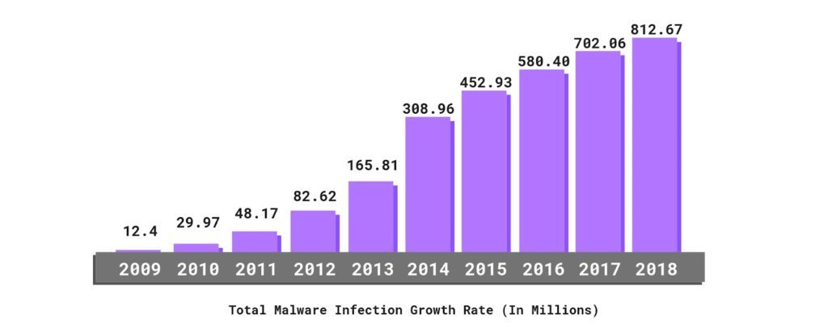
Introduction
In an era, where our lives are increasingly intertwined with technology, the prevalence of network cyber attacks has become a ubiquitous concern. From individuals to multinational corporations and governments, no entity is immune to the threat of cybercrime. These attacks manifest in various forms, from data breaches to ransomware extortion, leaving a trail of financial, reputational, and societal damage in their wake. Today, we'll explore the multifaceted challenges posed by network cyber attacks and examine how individuals and organizations worldwide are confronting these threats with resilience, innovation, and collaboration.

Slide 3
Problem Statement
Cybersecurity threats pose significant risks to organizations and individuals worldwide. With cyberattacks becoming increasingly complex and sophisticated, there is an urgent need to develop robust methods for detection and mitigation. To meet these challenges, a network intrusion detection technique is proposed, utilizing the collective power of multiple machine learning algorithms.

Slide 4
Research Questions
How can machine learning algorithms be applied to analyze the UNSW-NB15 dataset and detect different types of cyber-attacks?
What are the key features and patterns indicative of malicious activities in network traffic data?
How do different machine learning models perform in terms of accuracy, sensitivity, and specificity for cybersecurity threat detection?

Slide 5
Steps involved in implementation of our system
Data Collection
Model Evaluation
Data Preprocessing
Model Selection and Training
Feature Engineering
Data from UNSW,Canberra
Data cleaning, preparing data
to apply ML techniques
Feature selection and approaches
to use required features
Traditional, Ensemble and Neural Networks
techniques
Accuracy, F1 score, Precision, and Recall metrics

Slide 6
Dataset
Source :
University of South Wales, Canberra
Validation :
The UNSW-NB 15 dataset's raw network packets were generated in the Cyber Range Lab of UNSW Canberra using the IXIA PerfectStorm tool. This process aimed to produce a blend of genuine, contemporary normal activities and artificially generated attack behaviors.
Format :
The data is accessible in CSV format files.
Size :
The dataset is present in two files, Training data file contains 175342 records with file size 32.5 mb, and testing data file contains 82333 records with file size 15.7 mb.

Slide 7
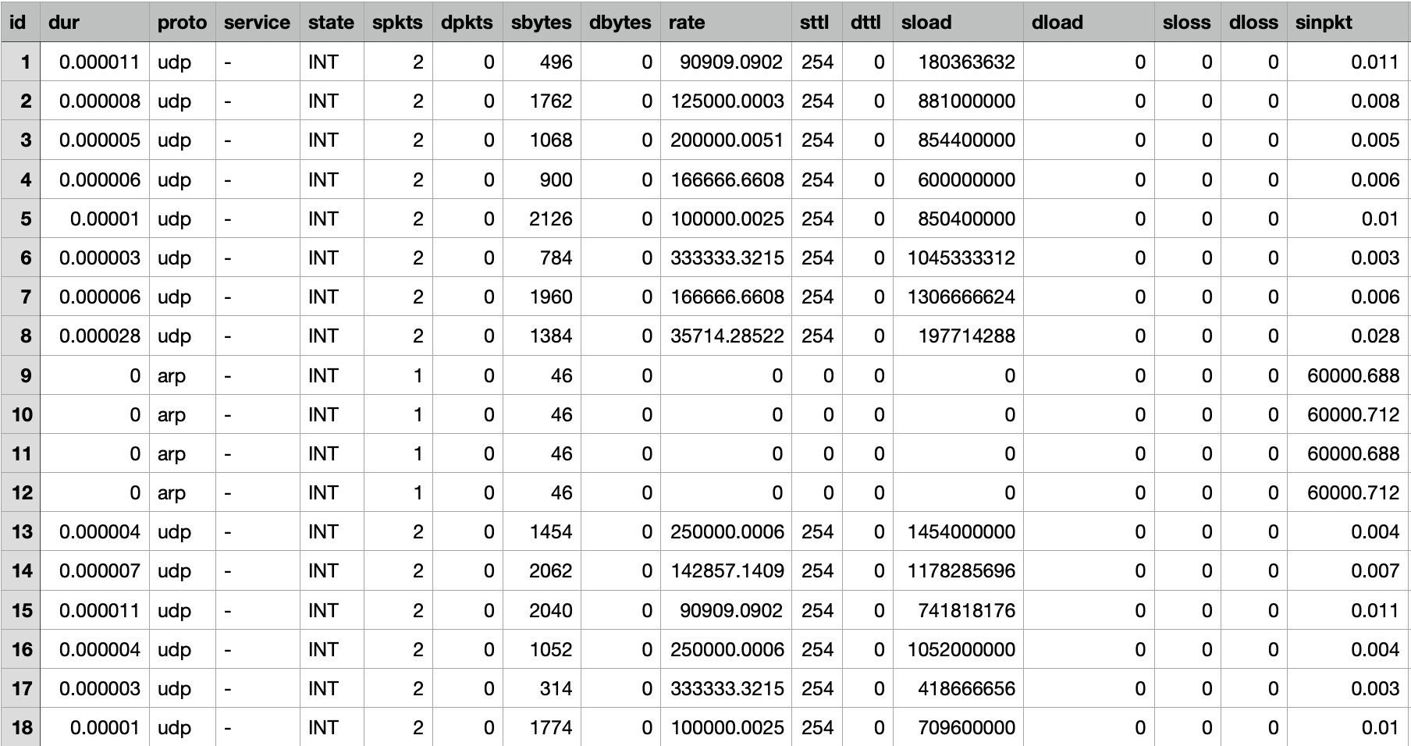

Slide 8
Target Variable
"attack_cat" is the target variable.
Types of Attack:
Normal
Fuzzers
Analysis
Backdoors
DoS (Denial of Service)
Exploits
Generic
Reconnaissance
Shellcode
Worms

Slide 9
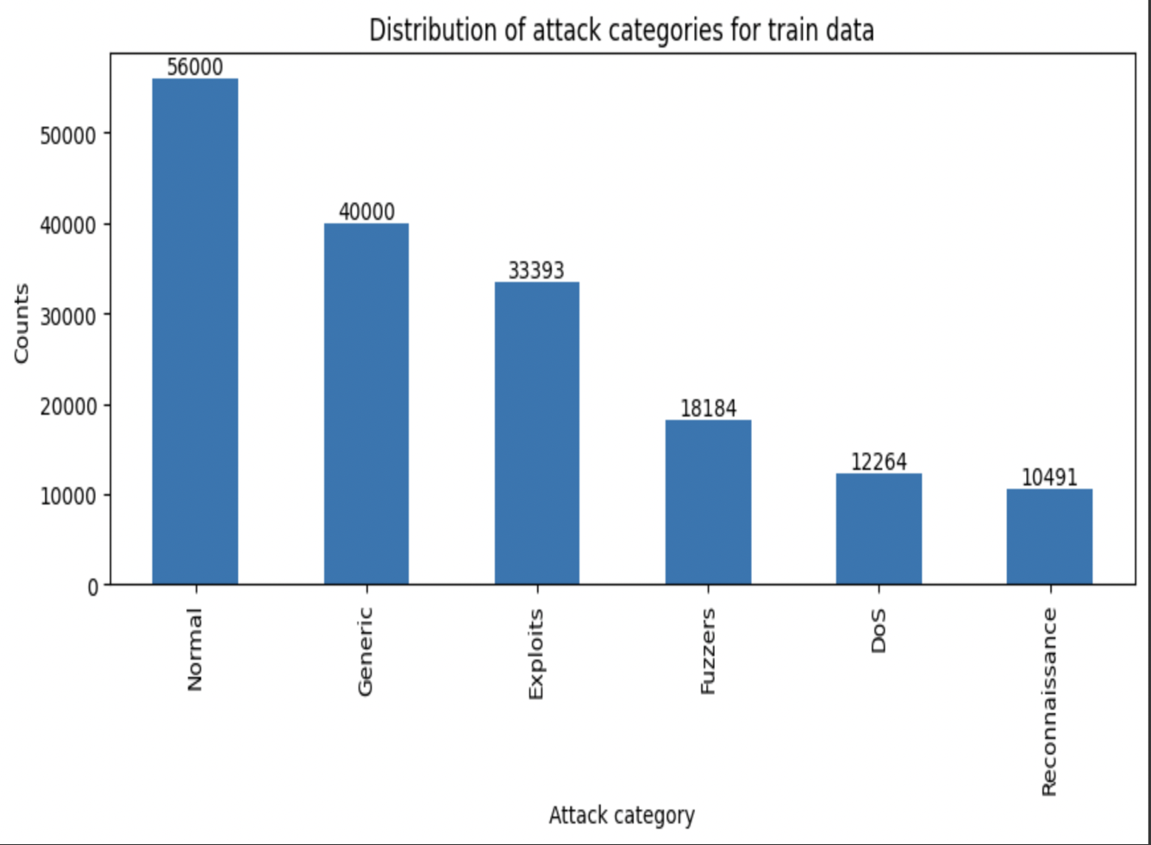
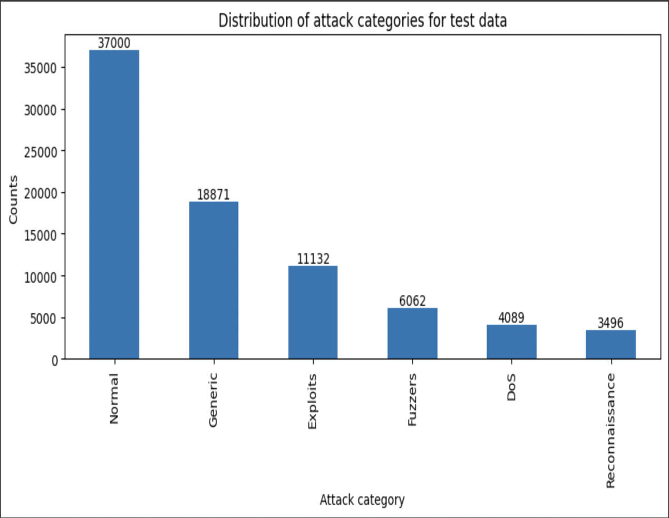
Data Preprocessing
In target variable "attack_cat", we are removing all instances corresponding to these categories from both the training and testing datasets. There are relatively fewer instances of the following attack categories:
Analysis
Backdoor
Shellcode
Worms

Slide 10
Class mapping
Class 0
DoS (Denial of Service)
Class 1
Exploits
Class 2
Fuzzers
Class 3
Generic
Class 4
Normal
Class 5
Reconnaissance

Slide 11
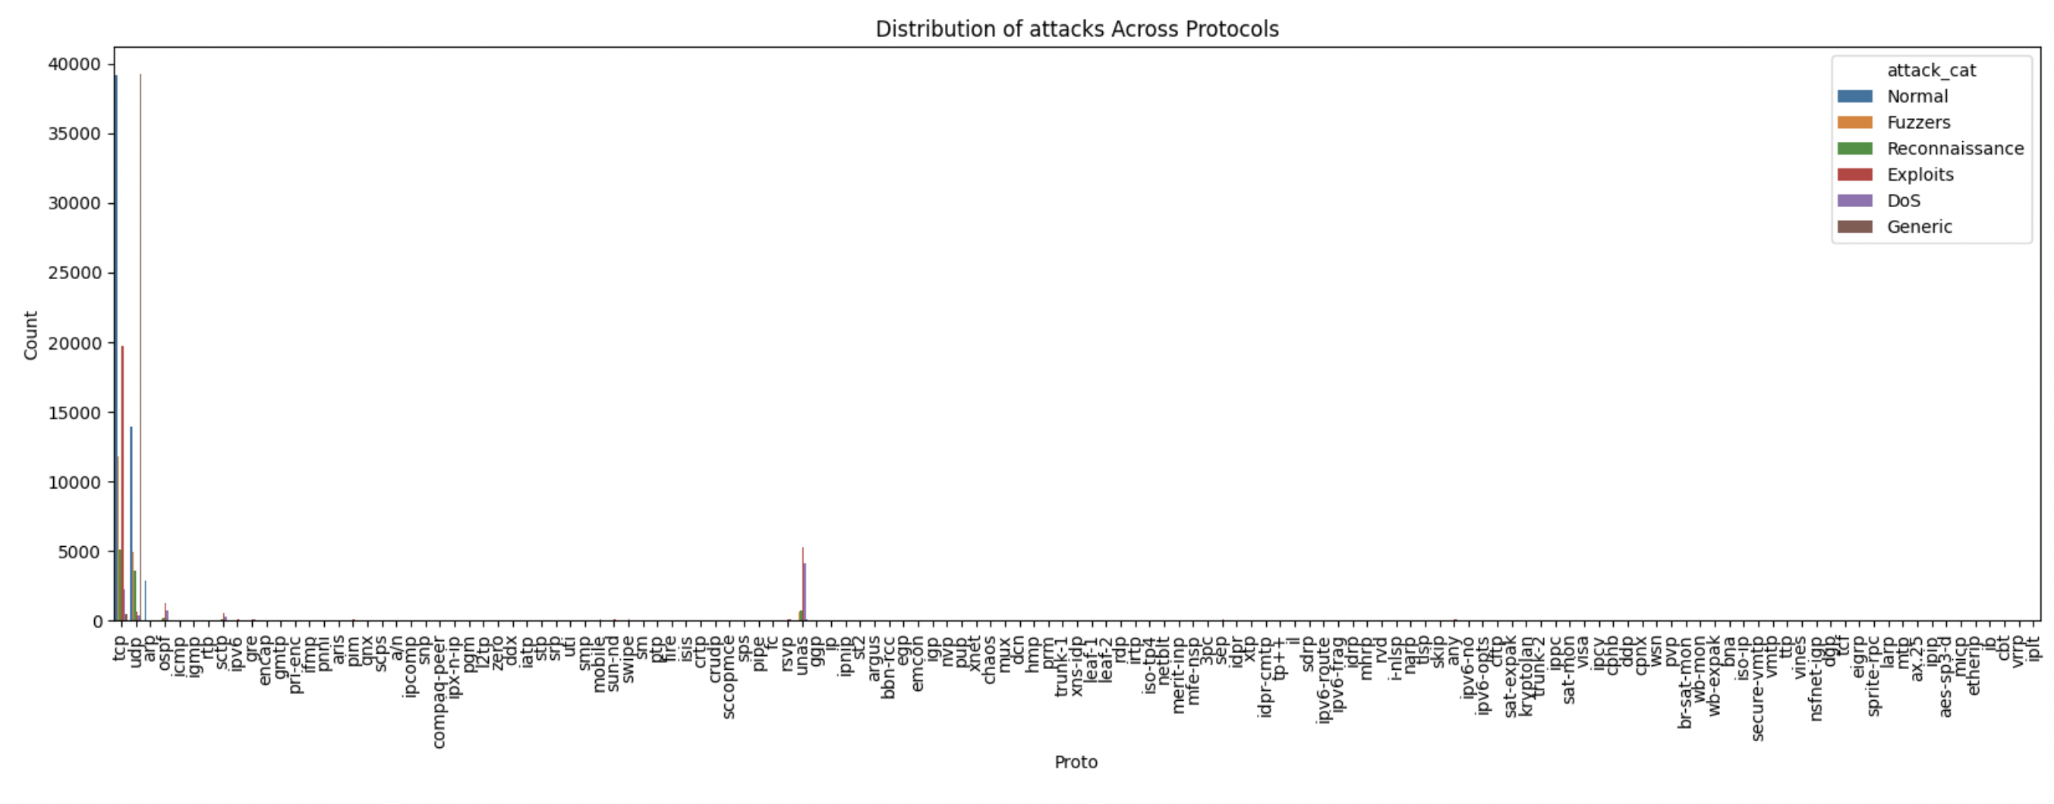
Exploratory Data Analysis
This is distribution of attacks across Protocols.

Slide 12
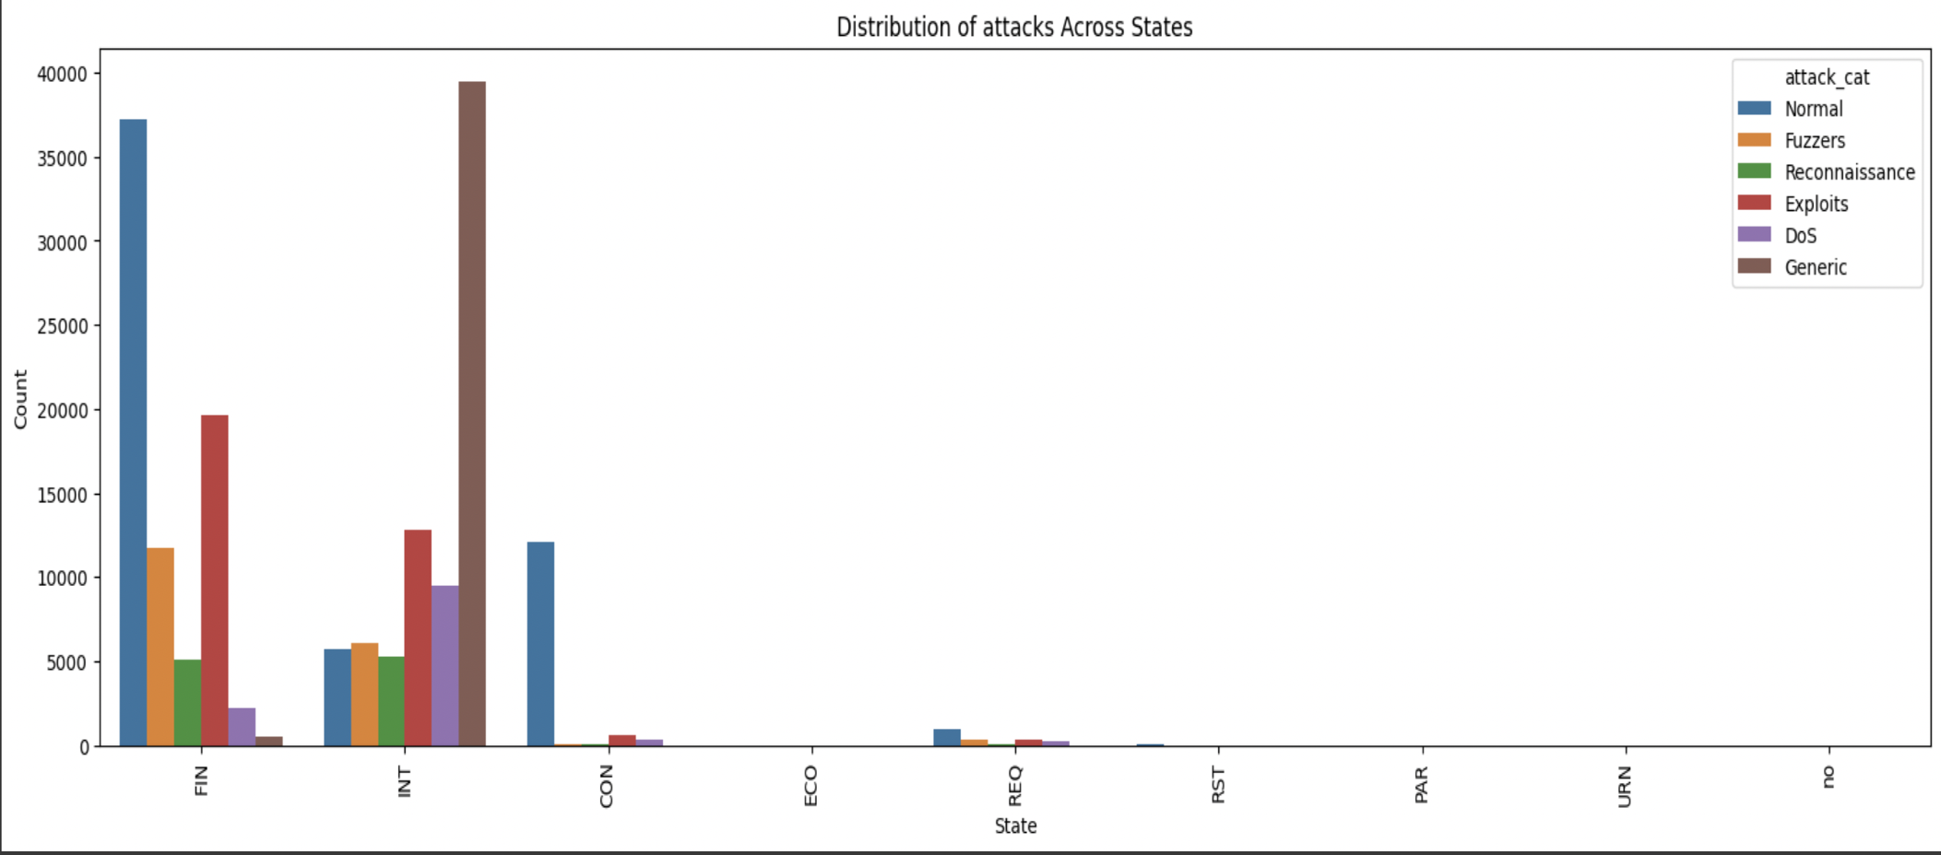
Exploratory Data Analysis
Here, we are seeing the distribution of attacks across state which indicates the state of protocols.

Slide 13
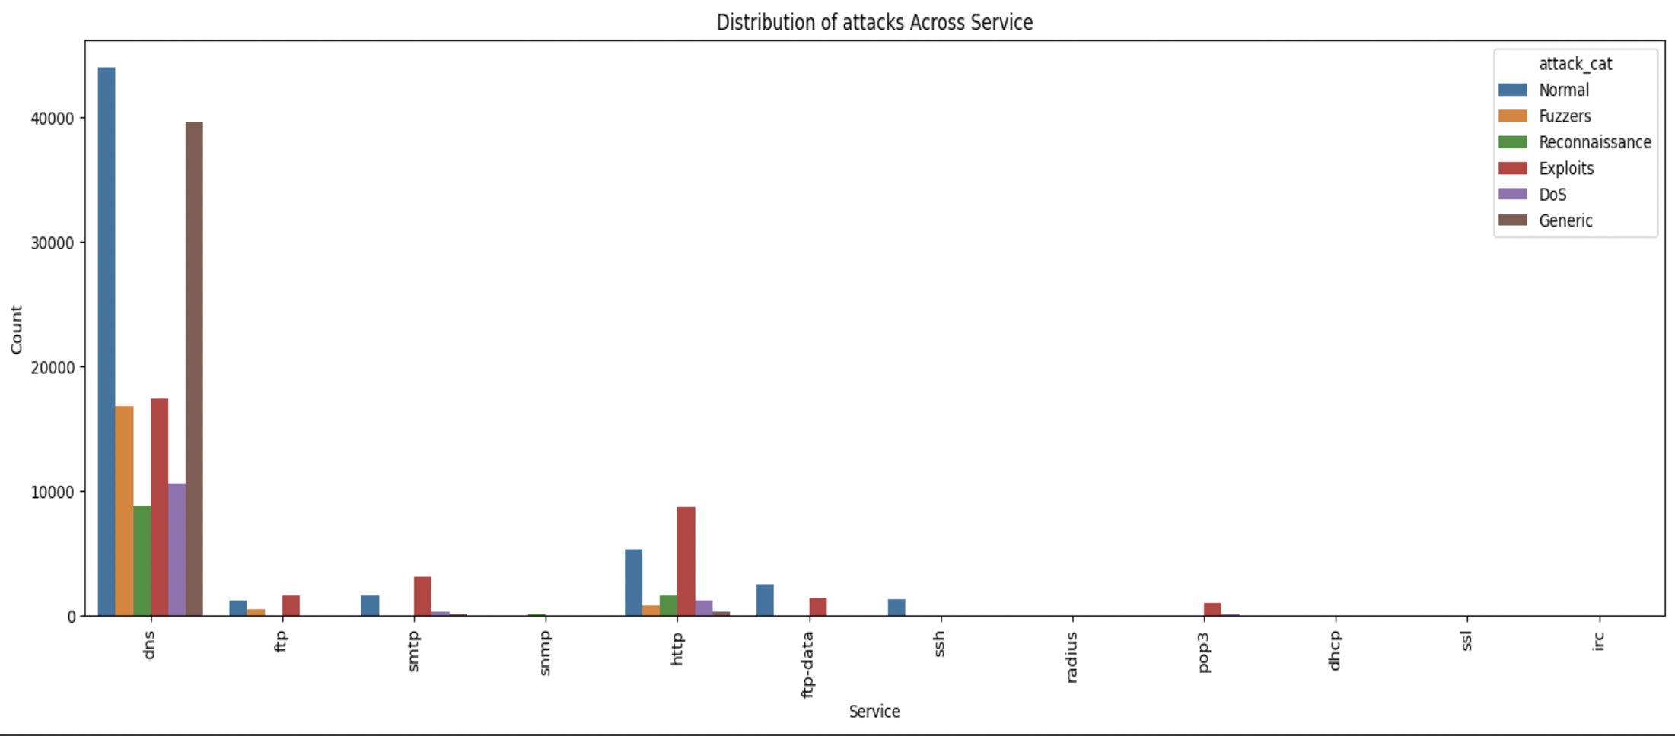
This is distribution of attacks across Services.

Slide 14
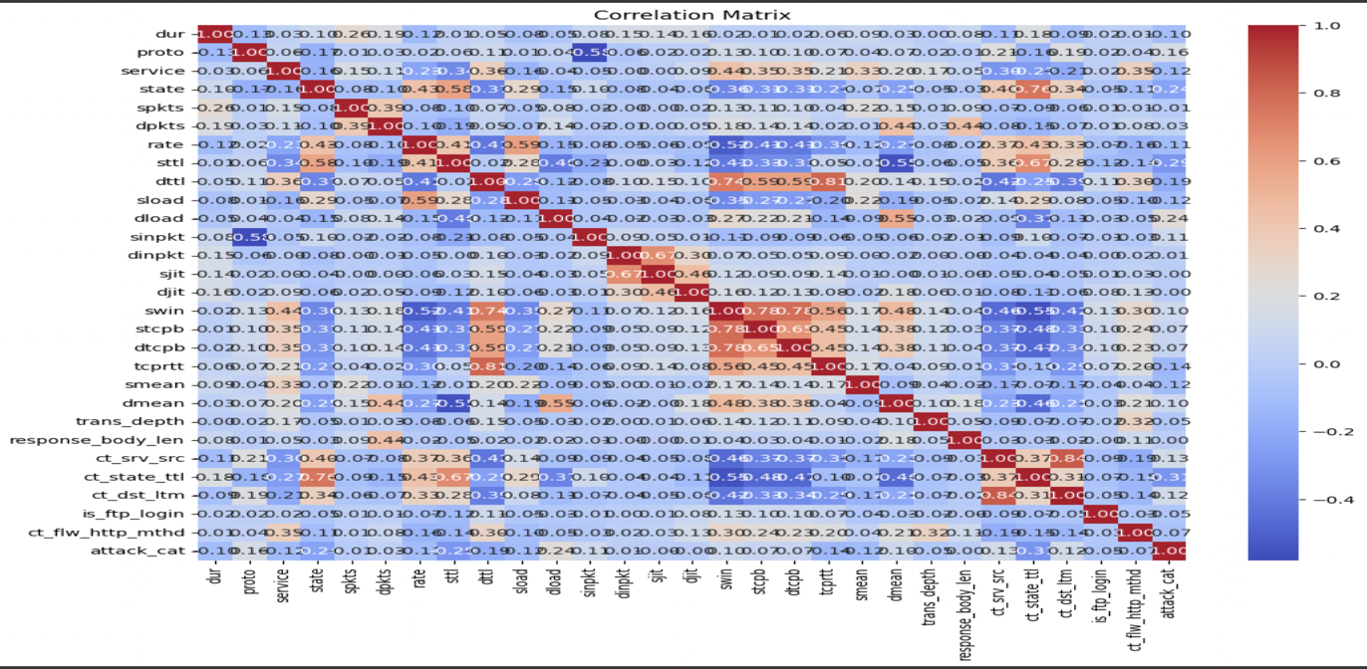
Feature Selection
Our dataset contains 43 attributes which has dependent and independent variables. To get good accuracy, we need to remove unnecessary attributes. We have used following methods for it
Correlation matrix
Using this technique, 28 attributes were taken into consideration.

Slide 15
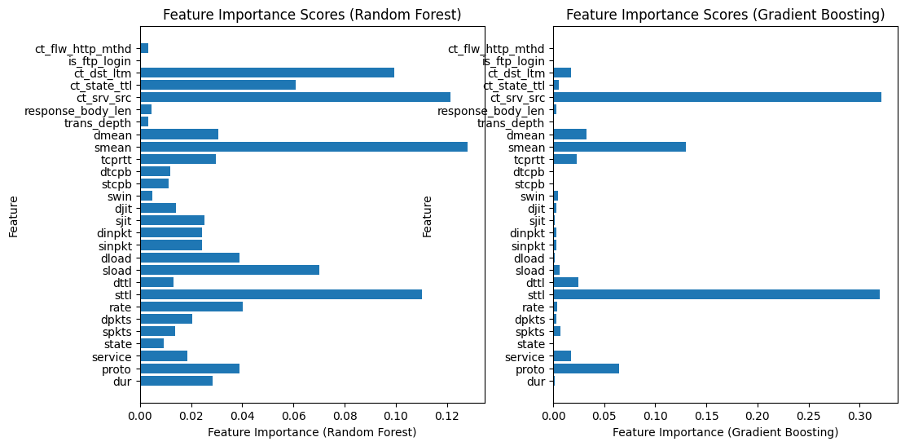
Random forest
Gradient boost

Slide 16
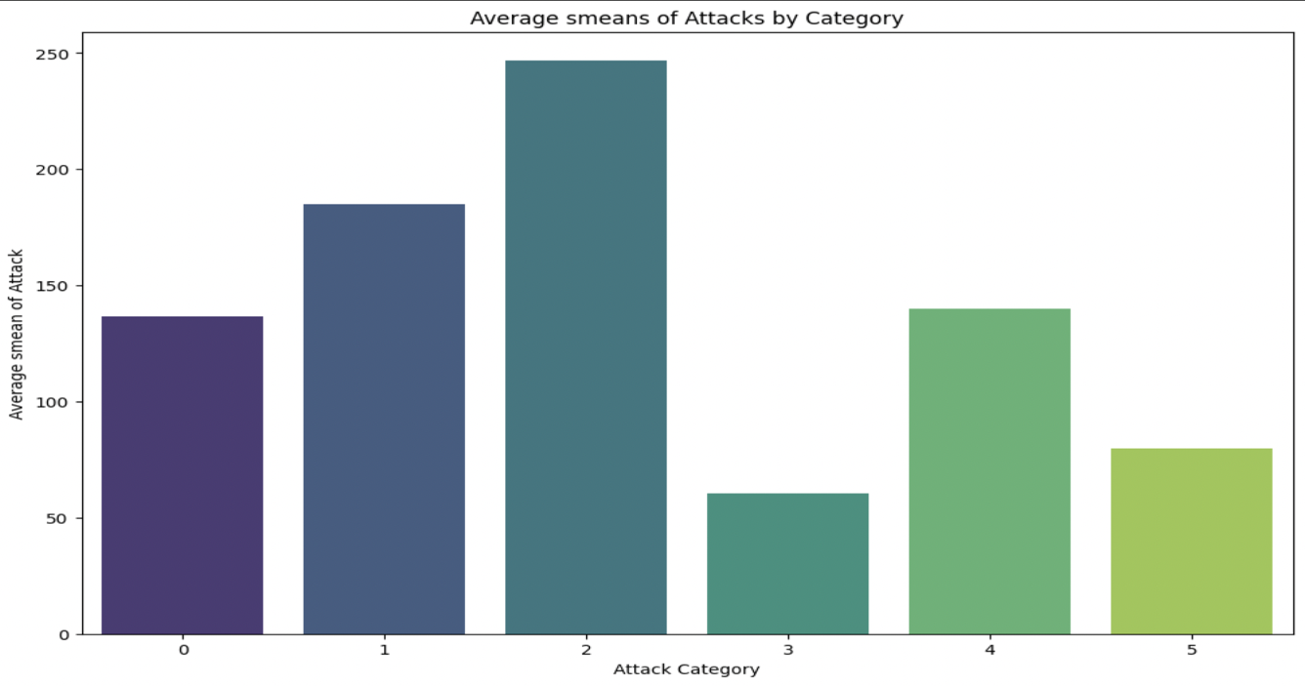
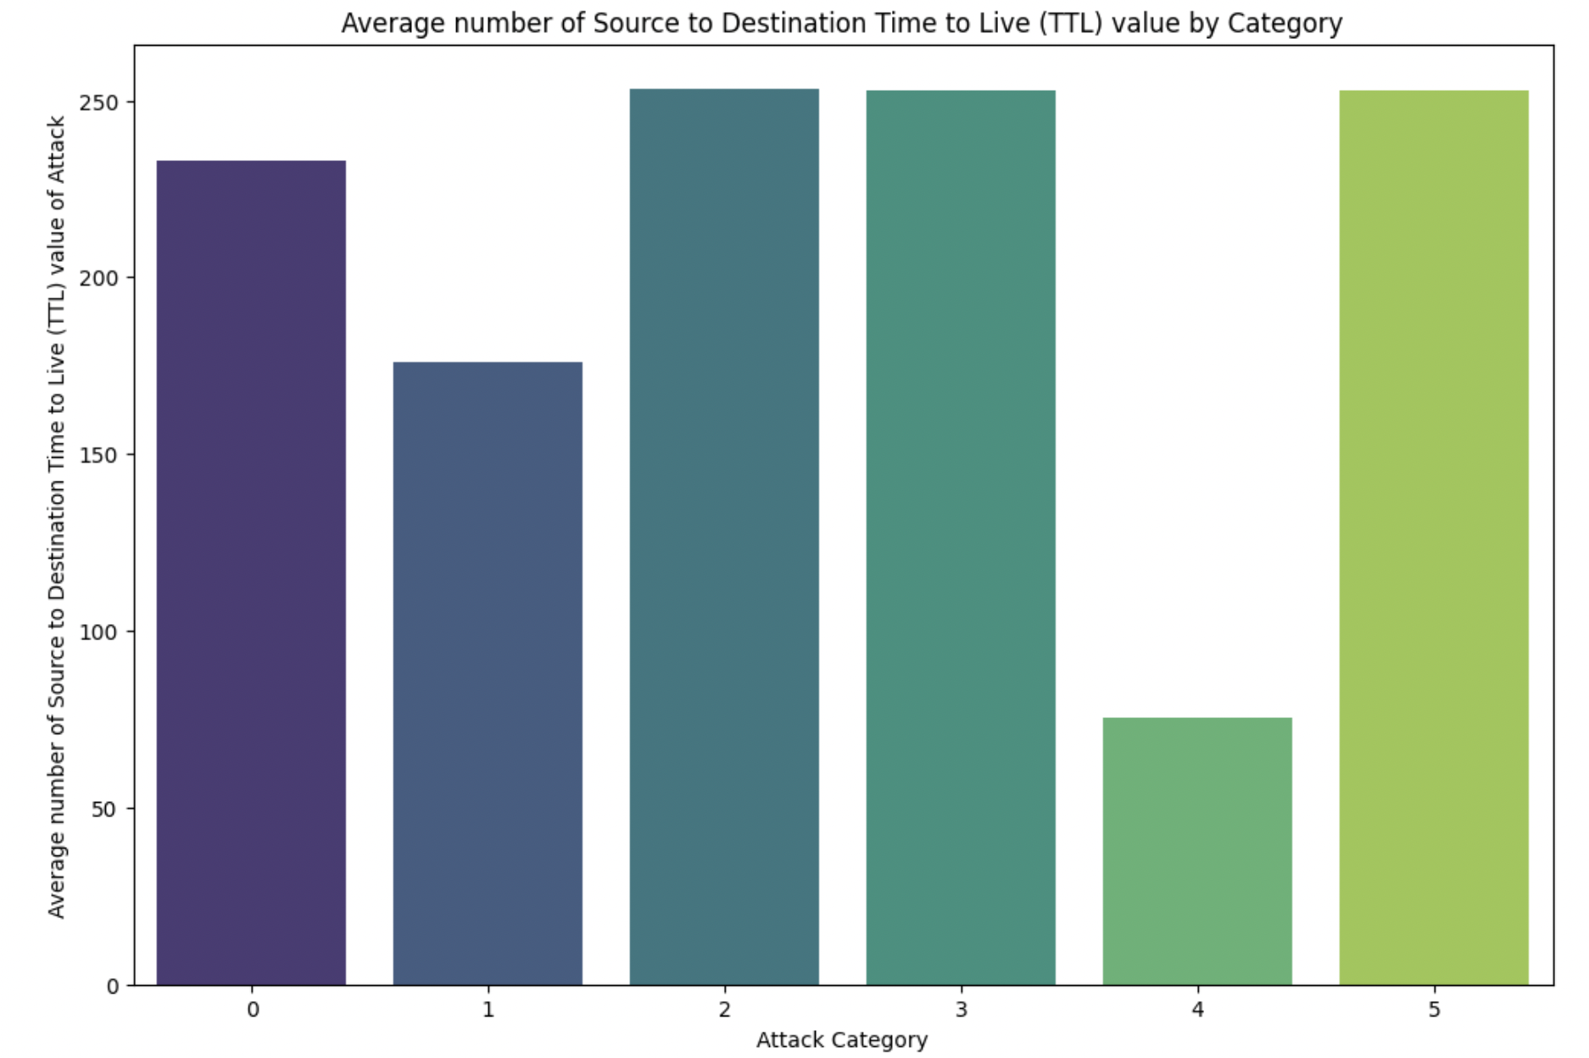
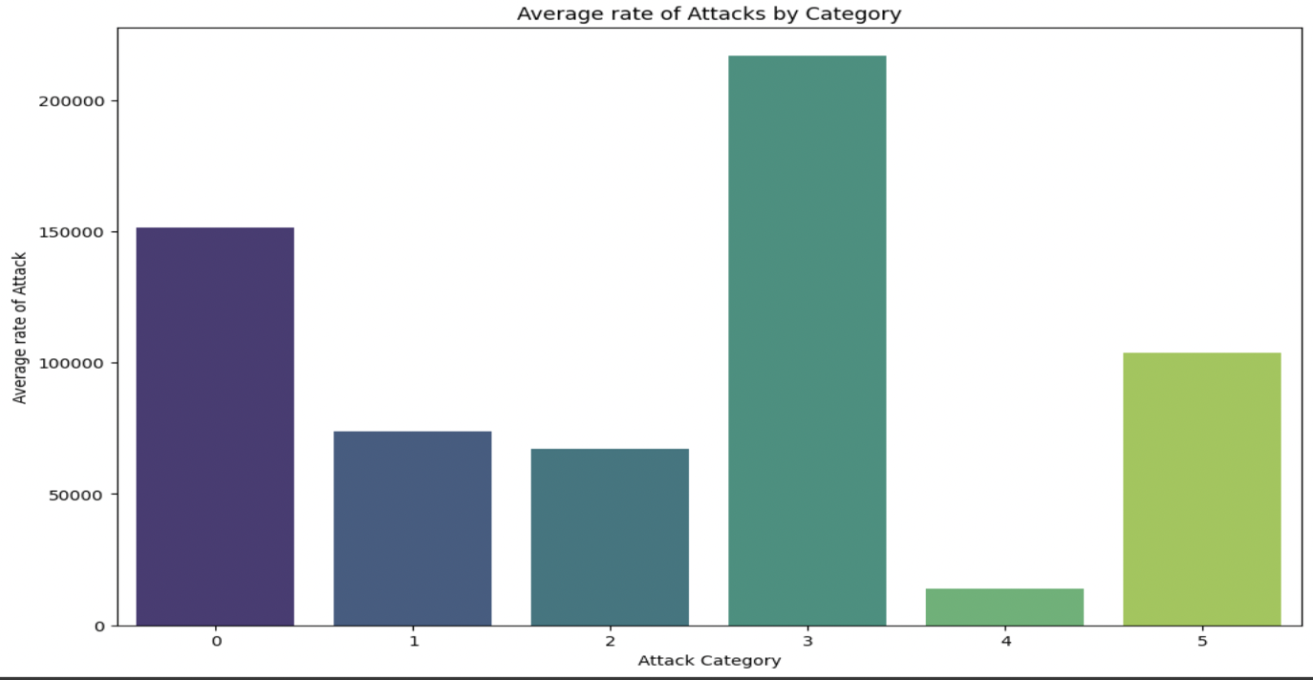
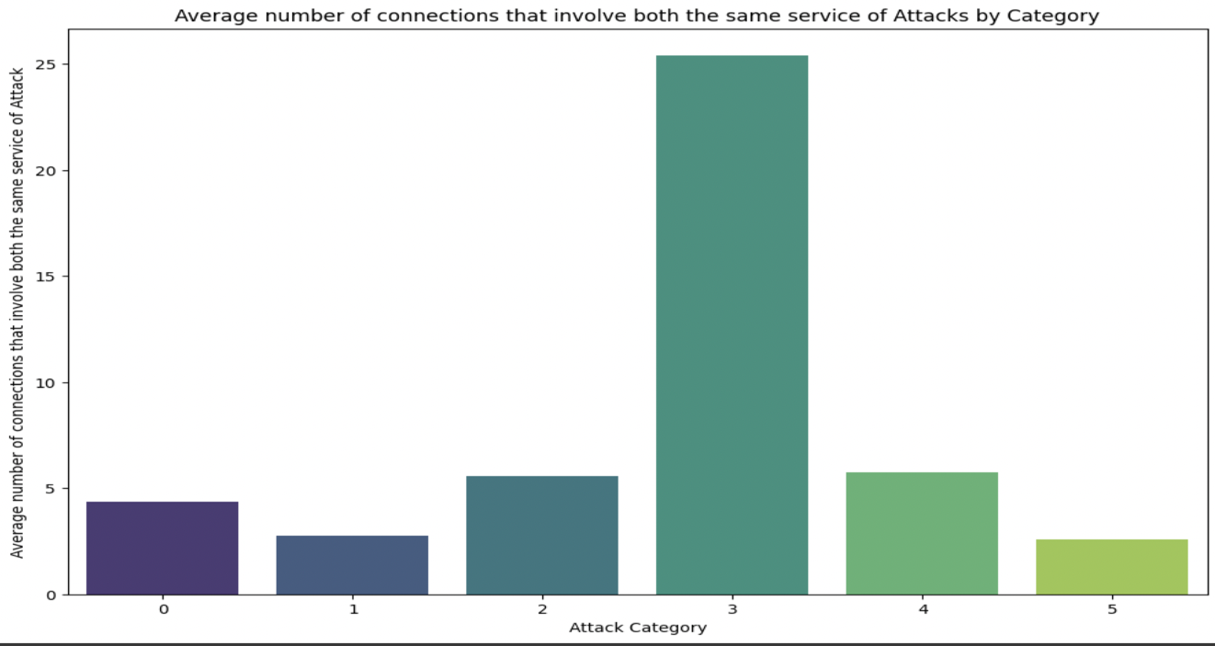

Slide 17
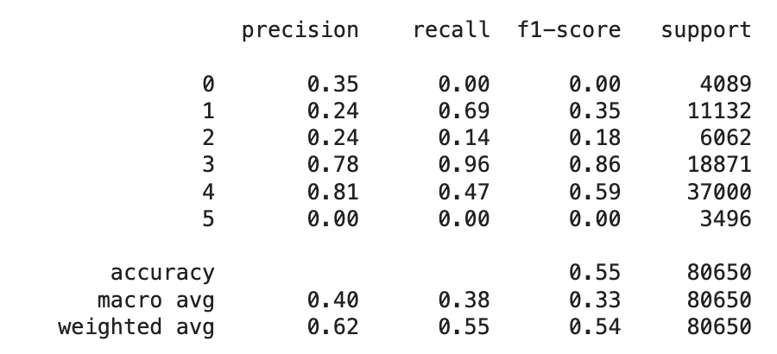
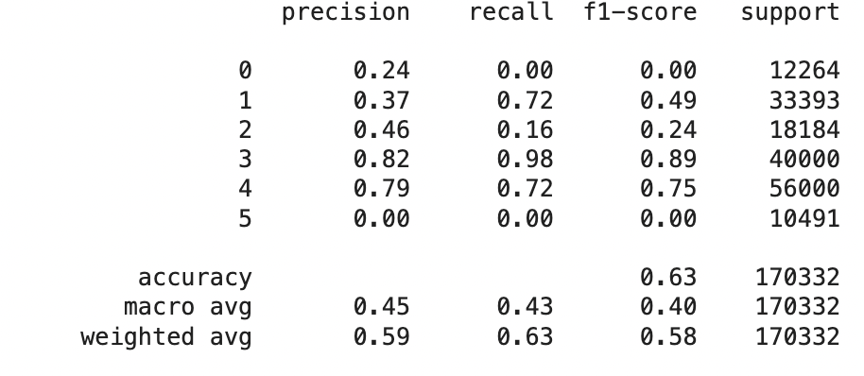
Traditional Learning Methods
Implementation
We have applied couple of machine learning techniques.
Logistic Regression
Logistic Regression Classifier on Train and Test Data

Slide 18
Logistic Regression Classifier with balanced Class Weight on Train Data and Test Data
Class | Precision | Recall | F1 Score | Support
0 | 0.32 | 0.69 | 0.44 | 12264
1 | 0.33 | 0.13 | 0.19 | 33393
2 | 0.28 | 0.78 | 0.41 | 18184
3 | 0.89 | 0.98 | 0.93 | 40000
4 | 0.91 | 0.59 | 0.71 | 56000
5 | 0.00 | 0.00 | 0.00 | 10491
Class | Precision | Recall | F1 Score | Support
0 | 0.30 | 0.61 | 0.40 | 4089
1 | 0.32 | 0.17 | 0.22 | 11132
2 | 0.15 | 0.71 | 0.24 | 6062
3 | 0.83 | 0.96 | 0.89 | 18871
4 | 0.91 | 0.37 | 0.53 | 37000
5 | 0.00 | 0.00 | 0.00 | 3496

Slide 19
Logistic Regression Classifier with SMOTE on Train Data and Test Data
Class | Precision | Recall | F1 Score | Support
0 | 0.12 | 0.74 | 0.21 | 12264
1 | 0.00 | 0.00 | 0.00 | 33393
2 | 0.19 | 0.57 | 0.29 | 18184
3 | 0.01 | 0.00 | 0.00 | 40000
4 | 0.81 | 0.60 | 0.69 | 56000
5 | 0.00 | 0.00 | 0.00 | 10491
Class | Precision | Recall | F1 Score | Support
0 | 0.08 | 0.68 | 0.15 | 4089
1 | 0.00 | 0.00 | 0.00 | 11132
2 | 0.11 | 0.54 | 0.18 | 6062
3 | 0.20 | 0.00 | 0.00 | 18871
4 | 0.83 | 0.42 | 0.56 | 37000
5 | 0.00 | 0.00 | 0.00 | 3496
Logistic Regression Classifier with Grid search on Train Data and Test Data
Class | Precision | Recall | F1 Score | Support
0 | 0.00 | 0.00 | 0.00 | 12264
1 | 0.37 | 0.72 | 0.49 | 33393
2 | 0.46 | 0.16 | 0.23 | 18184
3 | 0.82 | 0.98 | 0.89 | 40000
4 | 0.79 | 0.72 | 0.75 | 56000
5 | 0.00 | 0.00 | 0.00 | 10491
Class | Precision | Recall | F1 Score | Support
0 | 0.00 | 0.00 | 0.00 | 4089
1 | 0.24 | 0.69 | 0.35 | 11132
2 | 0.24 | 0.14 | 0.18 | 6062
3 | 0.78 | 0.96 | 0.86 | 18871
4 | 0.80 | 0.47 | 0.59 | 37000
5 | 0.00 | 0.00 | 0.00 | 3496

Slide 20
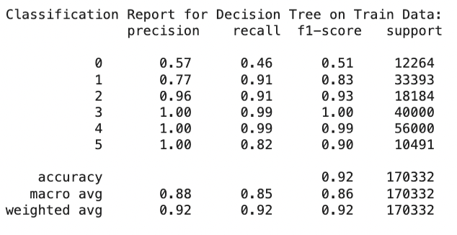
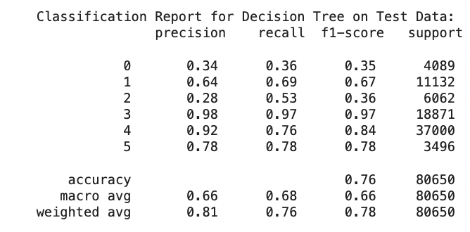
Decision Tree Classifier

Slide 21
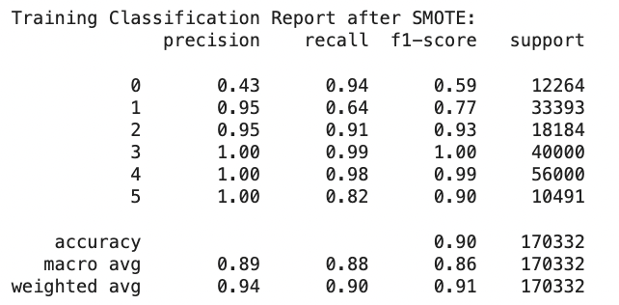
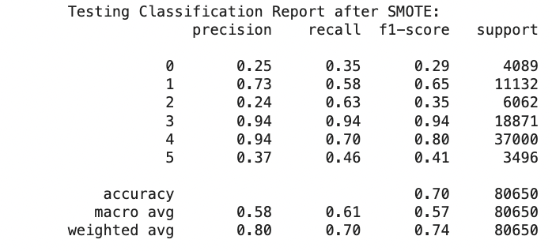
Decision Tree Classifier with SMOTE(Synthetic Minority Over-sampling Technique)

Slide 22
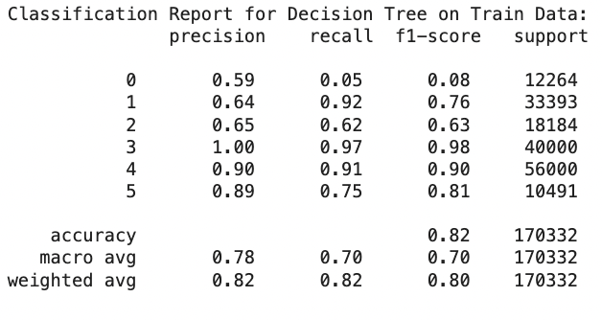
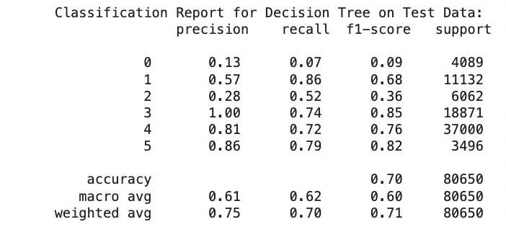
Decision Tree Classifier with Pruning Techniques

Slide 23
Decision Tree Classifier with grid search on Train Data and Test Data
Class | Precision | Recall | F1 Score | Support
0 | 0.00 | 0.00 | 0.00 | 12264
1 | 0.53 | 0.89 | 0.67 | 33393
2 | 0.30 | 0.49 | 0.37 | 18184
3 | 1.00 | 0.91 | 0.95 | 40000
4 | 0.95 | 0.82 | 0.88 | 56000
5 | 0.00 | 0.00 | 0.00 | 10491
Class | Precision | Recall | F1 Score | Support
0 | 0.00 | 0.00 | 0.00 | 4089
1 | 0.42 | 0.82 | 0.55 | 11132
2 | 0.12 | 0.42 | 0.19 | 6062
3 | 1.00 | 0.67 | 0.80 | 18871
4 | 0.90 | 0.60 | 0.72 | 37000
5 | 0.00 | 0.00 | 0.00 | 3496

Slide 24
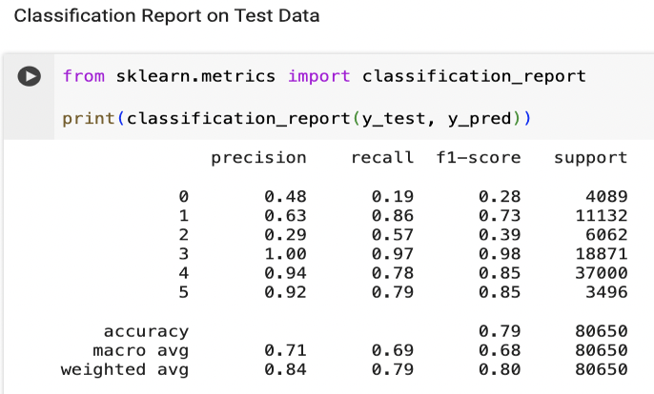
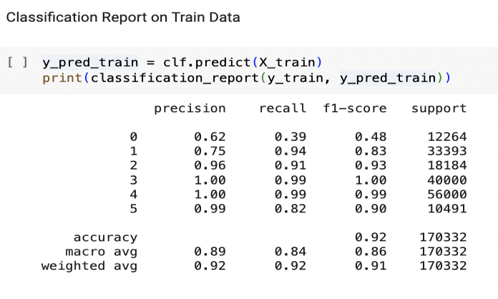
Ensembling
Random Forest Classifier

Slide 25
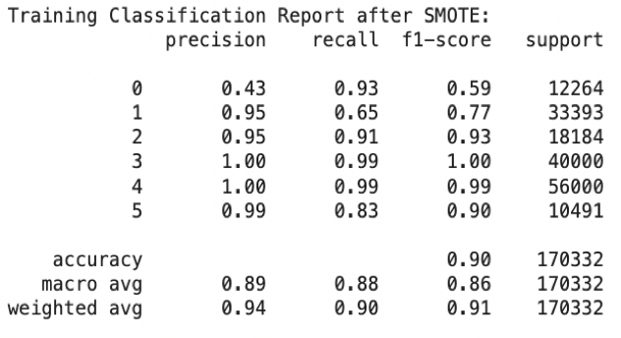
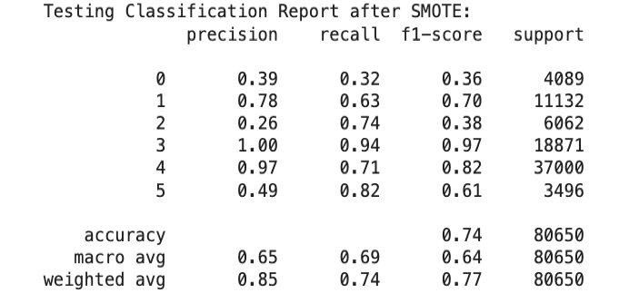
Random Forest Classifier with SMOTE(Synthetic Minority Over-sampling Technique)

Slide 26
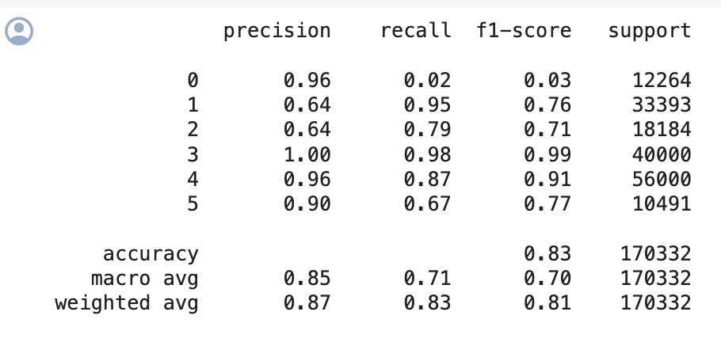
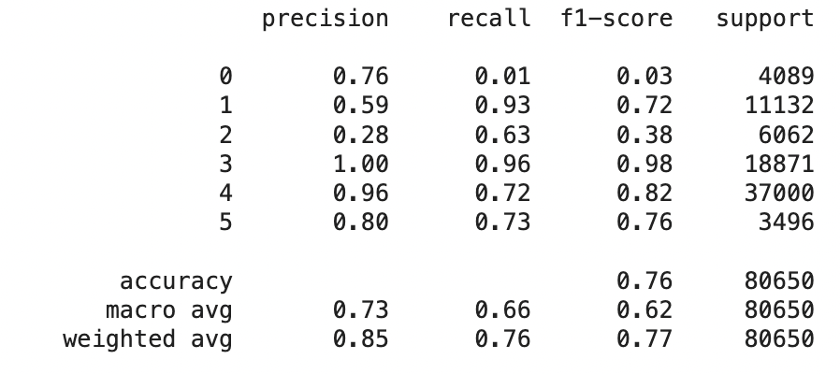
Random Forest Classifier with regularization and feature sampling on Train Data and Test Data
Classification report on Train Data
Classification report on Test Data

Slide 27
Random Forest Classifier with grid search on Train Data and Test Data
Class | Precision | Recall | F1 Score | Support
0 | 0.96 | 0.02 | 0.03 | 12264
1 | 0.64 | 0.95 | 0.76 | 33393
2 | 0.64 | 0.79 | 0.71 | 18184
3 | 1.00 | 0.98 | 0.99 | 40000
4 | 0.96 | 0.87 | 0.91 | 56000
5 | 0.90 | 0.67 | 0.77 | 10491
Class | Precision | Recall | F1 Score | Support
0 | 0.76 | 0.01 | 0.03 | 4089
1 | 0.59 | 0.93 | 0.72 | 11132
2 | 0.28 | 0.63 | 0.38 | 6062
3 | 1.00 | 0.96 | 0.98 | 18871
4 | 0.96 | 0.72 | 0.82 | 37000
5 | 0.80 | 0.73 | 0.76 | 3496

Slide 28
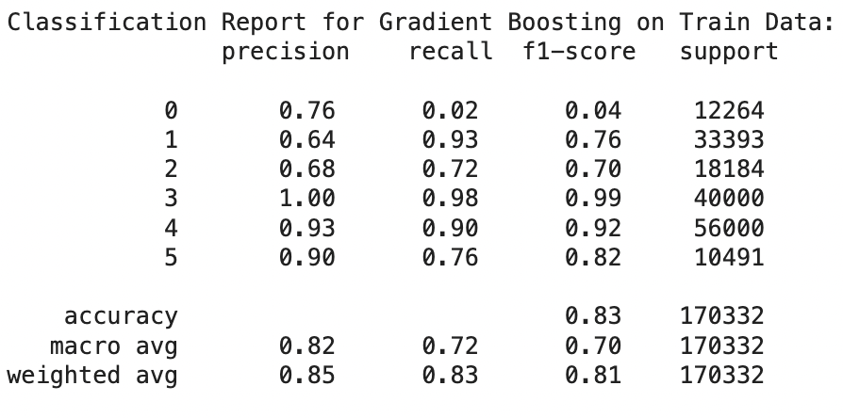
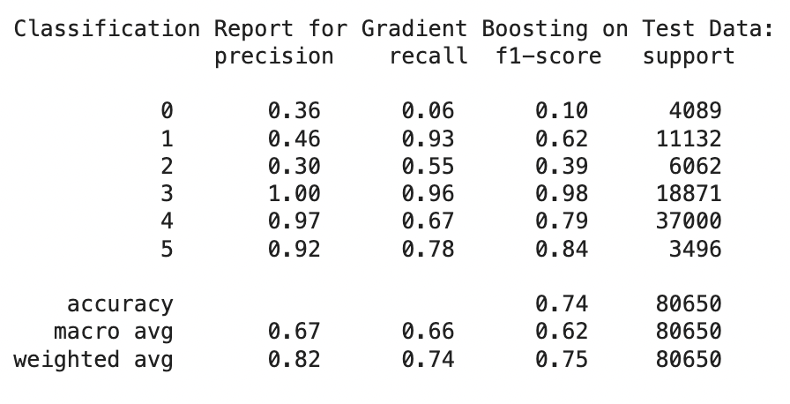
Gradient Boosting Classifier

Slide 29
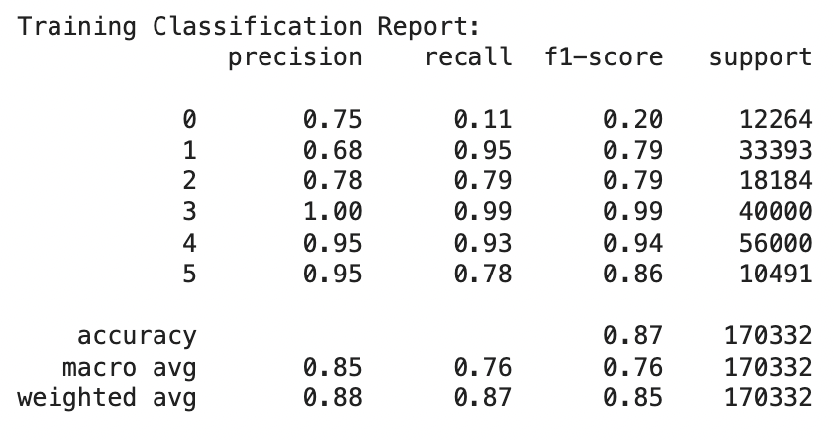
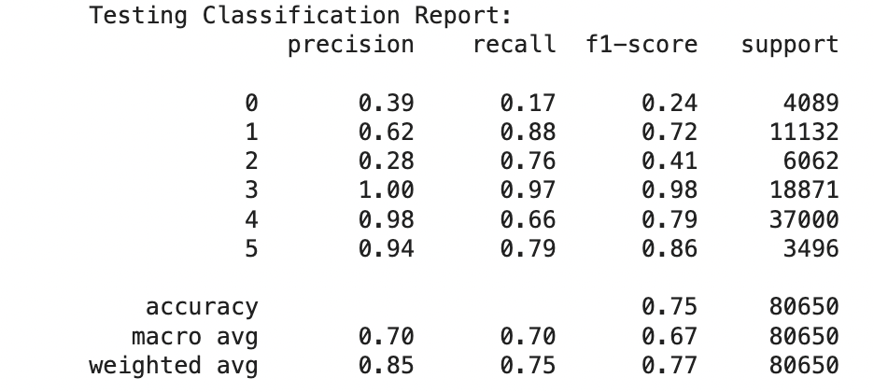
Xtreme Gradient Boosting

Slide 30
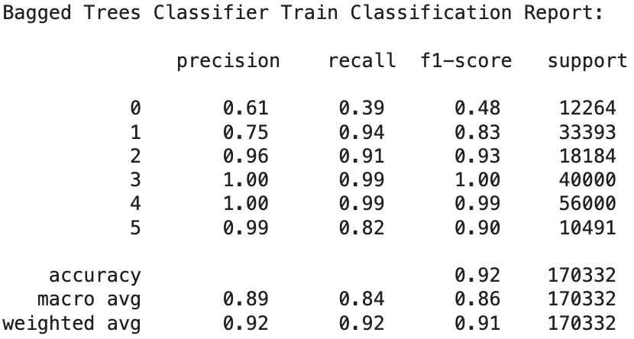
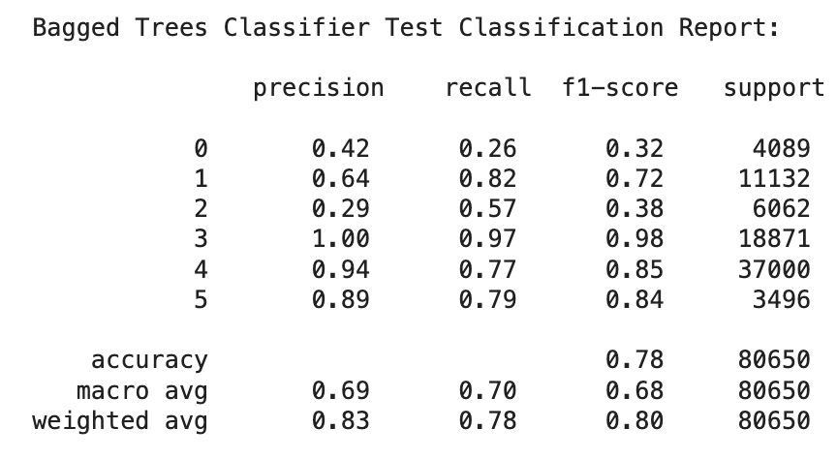
Bagging Classifier with Decision Tree Classifier

Slide 31
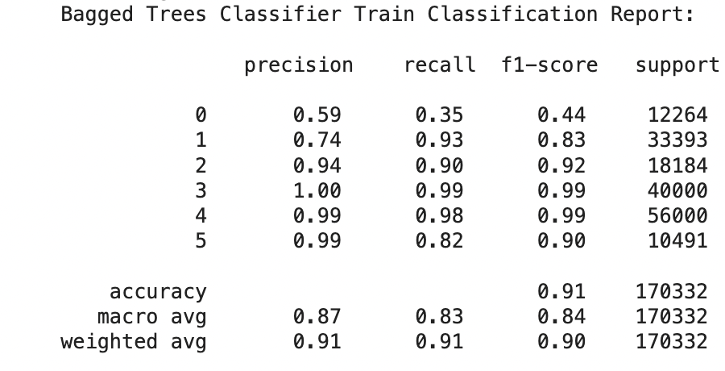
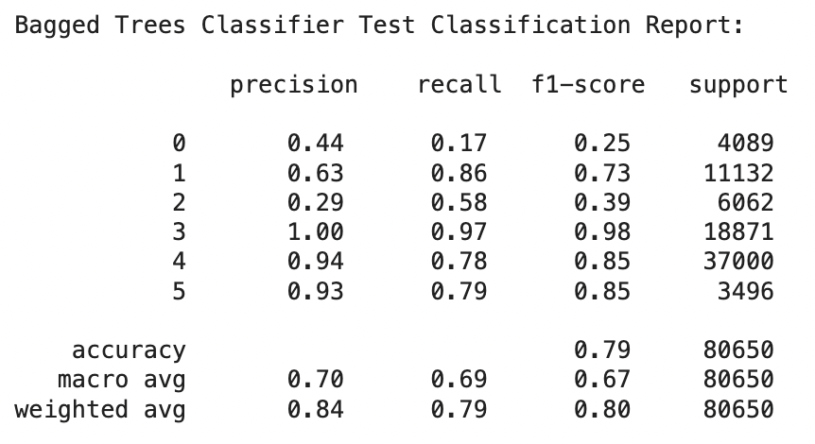
Bagging Classifier with Random Forest Classifier

Slide 32
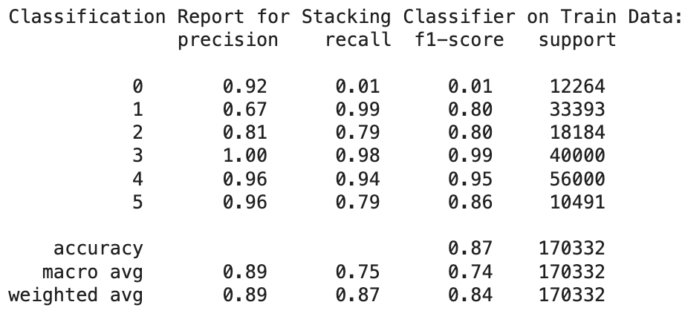
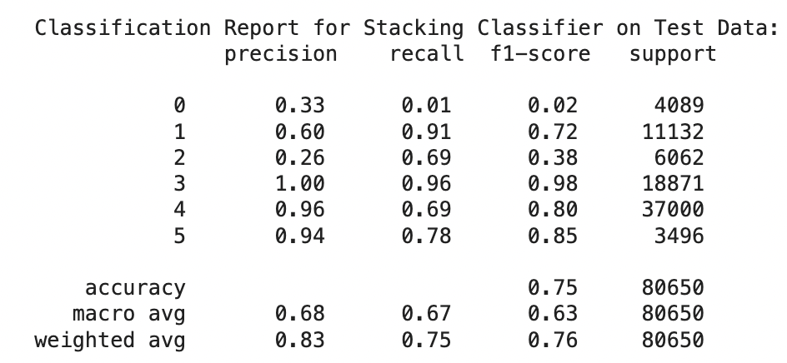
Stacking

Slide 33
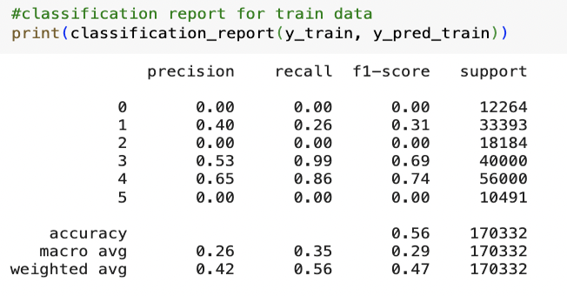
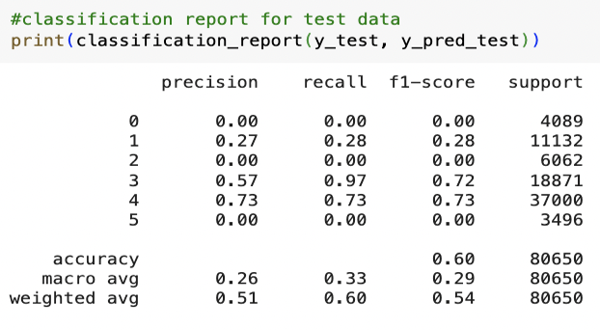
Fully Connected Neural Network
Fully Connected Neural Networks with adamw optimizer on Train and Test data
Class | Precision | Recall | F1 Score | Support
0 | 0.00 | 0.00 | 0.00 | 12264
1 | 0.38 | 0.22 | 0.28 | 33393
2 | 0.00 | 0.00 | 0.00 | 18184
3 | 0.51 | 0.99 | 0.67 | 40000
4 | 0.65 | 0.86 | 0.74 | 56000
5 | 0.00 | 0.00 | 0.00 | 10491
Class | Precision | Recall | F1 Score | Support
0 | 0.00 | 0.00 | 0.00 | 4089
1 | 0.27 | 0.27 | 0.27 | 11132
2 | 0.00 | 0.00 | 0.00 | 6062
3 | 0.55 | 0.97 | 0.70 | 18871
4 | 0.74 | 0.72 | 0.73 | 37000
5 | 0.00 | 0.00 | 0.00 | 3496

Slide 34
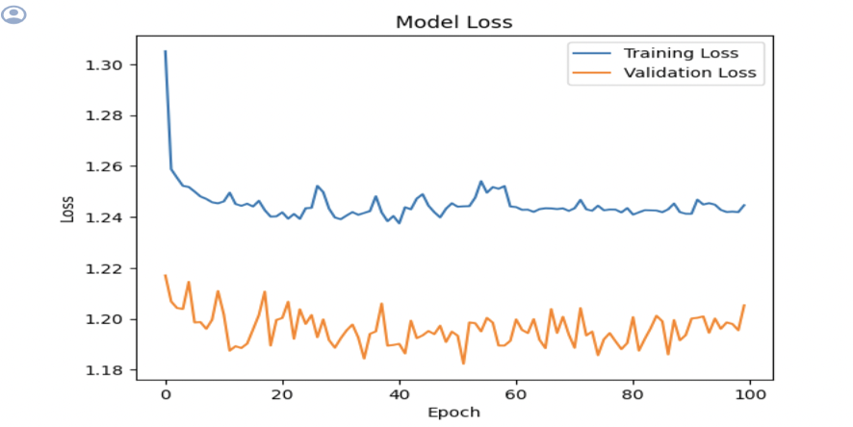
Plotting the training and validation loss

Slide 35
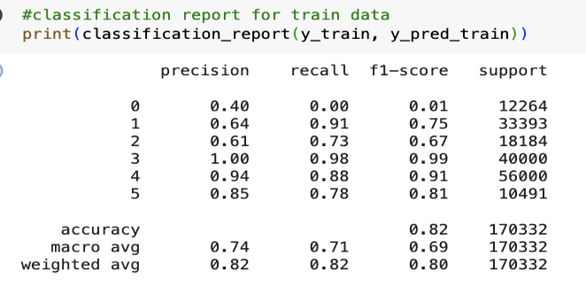
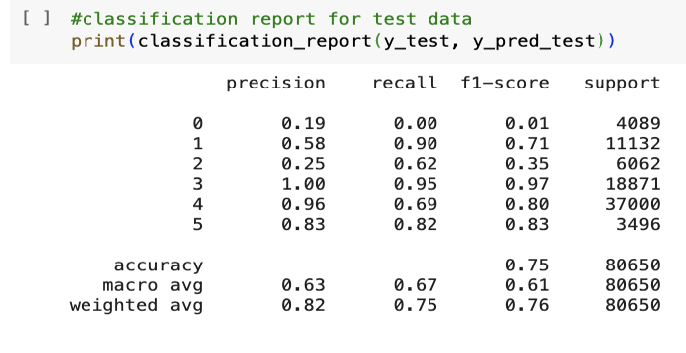
Convolutional Neural Network
Convolutional Neural Networks with adamw optimizer on Train data and Test data.
Class | Precision | Recall | F1 Score | Support
0 | 0.71 | 0.02 | 0.04 | 12264
1 | 0.64 | 0.94 | 0.76 | 33393
2 | 0.69 | 0.67 | 0.68 | 18184
3 | 1.00 | 0.98 | 0.99 | 40000
4 | 0.92 | 0.91 | 0.92 | 56000
5 | 0.87 | 0.77 | 0.82 | 10491
Class | Precision | Recall | F1 Score | Support
0 | 0.56 | 0.03 | 0.05 | 4089
1 | 0.57 | 0.93 | 0.71 | 11132
2 | 0.29 | 0.52 | 0.37 | 6062
3 | 1.00 | 0.96 | 0.98 | 18871
4 | 0.94 | 0.76 | 0.84 | 37000
5 | 0.86 | 0.81 | 0.84 | 3496

Slide 36
Plotting the training and validation loss

Slide 37
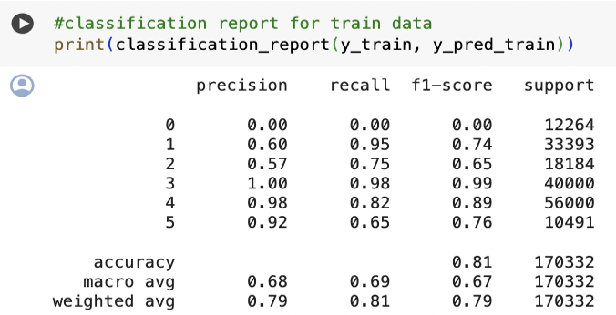
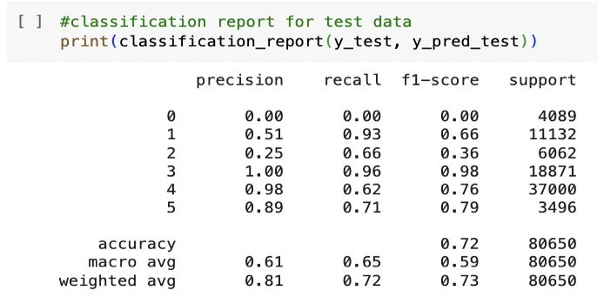
Recurrent neural network
Recurrent neural network with adamw optimizer on Train data and Test data
Class | Precision | Recall | F1 Score | Support
0 | 0.00 | 0.00 | 0.00 | 12264
1 | 0.63 | 0.92 | 0.75 | 33393
2 | 0.57 | 0.72 | 0.63 | 18184
3 | 0.99 | 0.98 | 0.98 | 40000
4 | 0.95 | 0.85 | 0.90 | 56000
5 | 0.81 | 0.70 | 0.75 | 10491
Class | Precision | Recall | F1 Score | Support
0 | 0.00 | 0.00 | 0.00 | 4089
1 | 0.57 | 0.87 | 0.69 | 11132
2 | 0.25 | 0.61 | 0.35 | 6062
3 | 0.98 | 0.95 | 0.96 | 18871
4 | 0.95 | 0.69 | 0.80 | 37000
5 | 0.73 | 0.74 | 0.74 | 3496

Slide 38
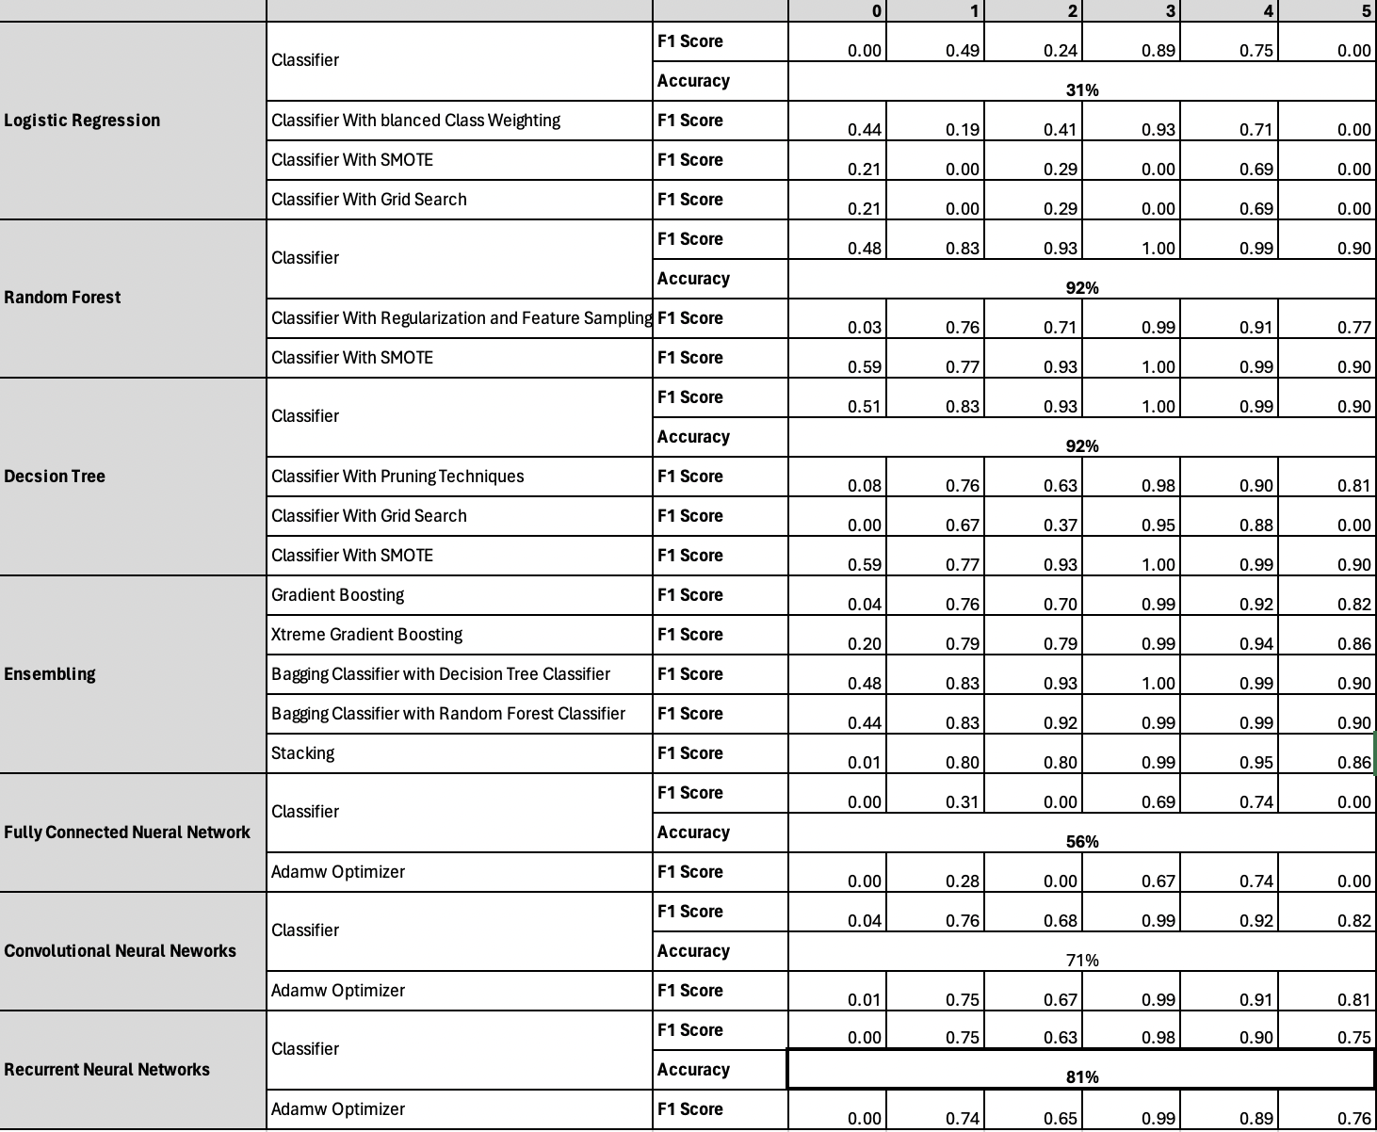

Slide 39
Future Implications
Storing data to MongoDB: When we were executing few machine learning models, it took few hours to execute. To avoid this, as of now we have planned to connect data to MongoDB server to execute in less time.
Extend data source: Not only the data that we have, also want to work with different data and huge data.
Real time data: With advancement of machine learning algorithms, intrusion detection system can become more capable of real time detection also and this helps many industries mitigate the impact of security breaches and prevent damage

Slide 40

Thank You All

